Slide 1
Diabetes Prediction
Health Analytics
Jianghong Man

Slide 2
Process Overview
Get the useful information for the training and test dataset
Select and process the existing files including:
Smoking status
Transcript
Weight, Height, BMI, SystolicBP, DiastolicBP, RespiratoryRate,
Diagnosis
Combine the data together to get the final file
Split training & test data
Build the model and predict

Slide 3
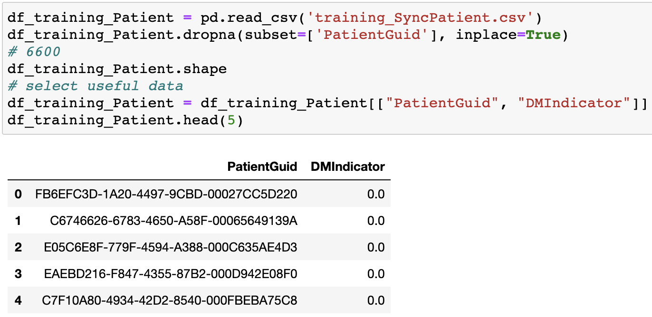
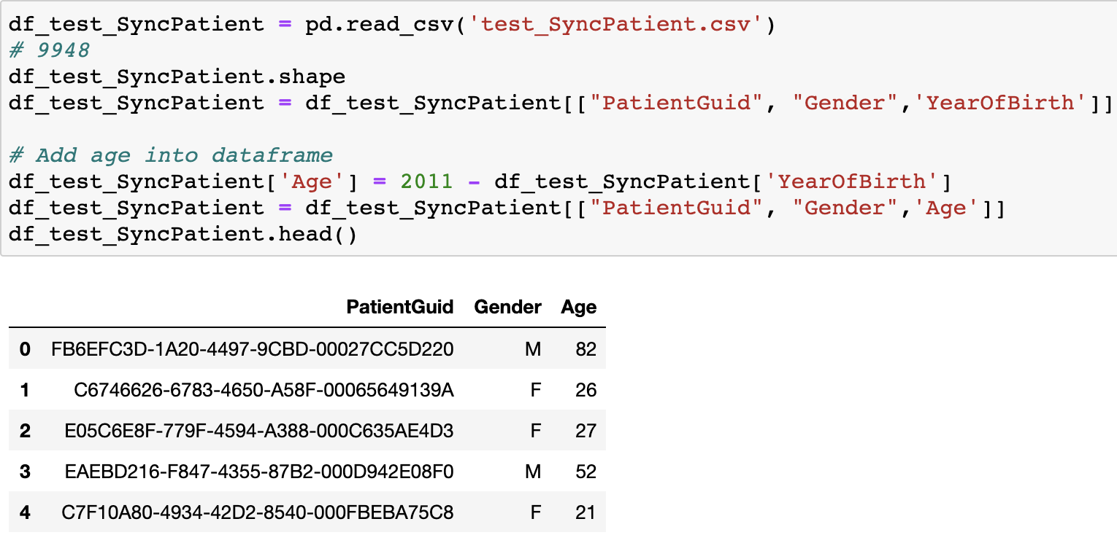
Get useful information

Slide 4
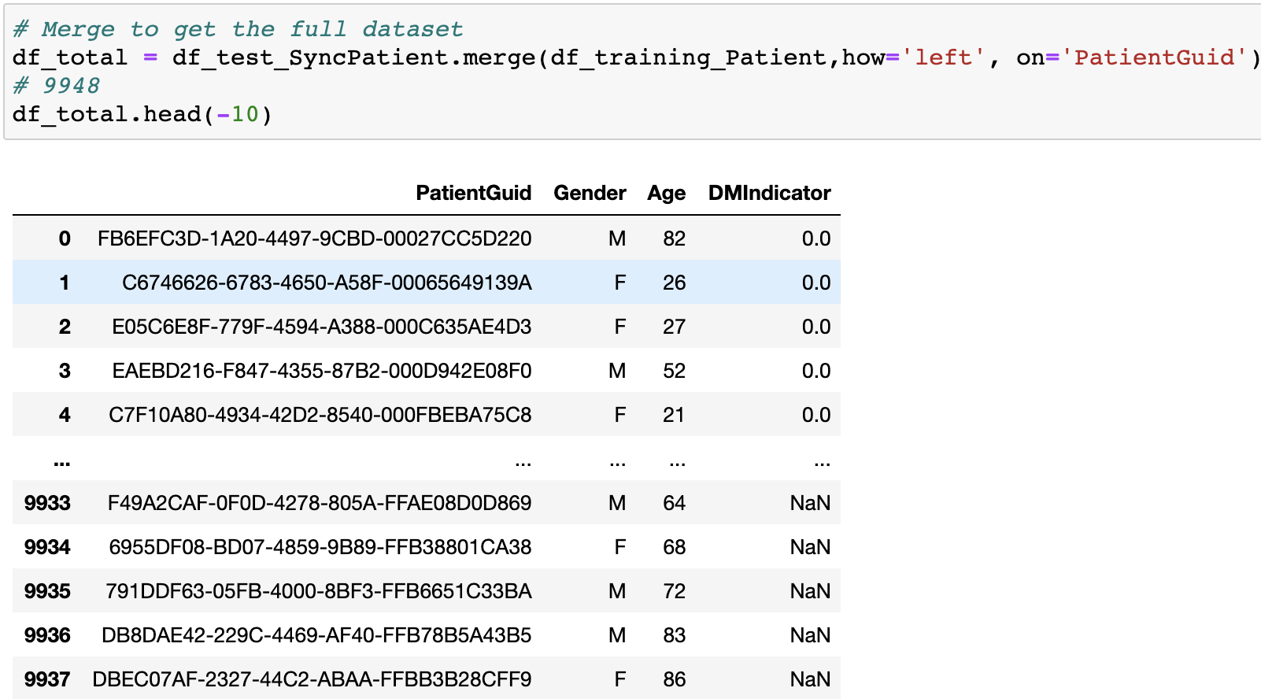
Get info

Slide 5
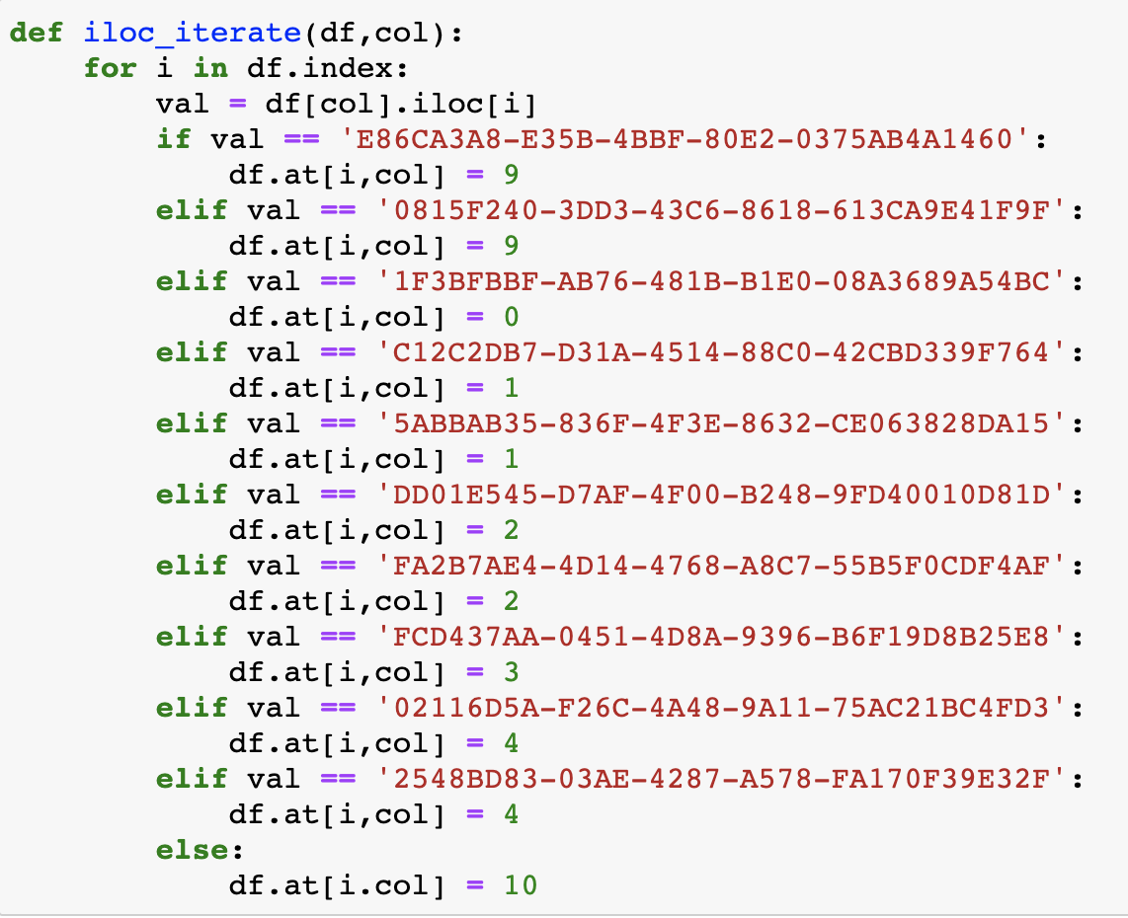
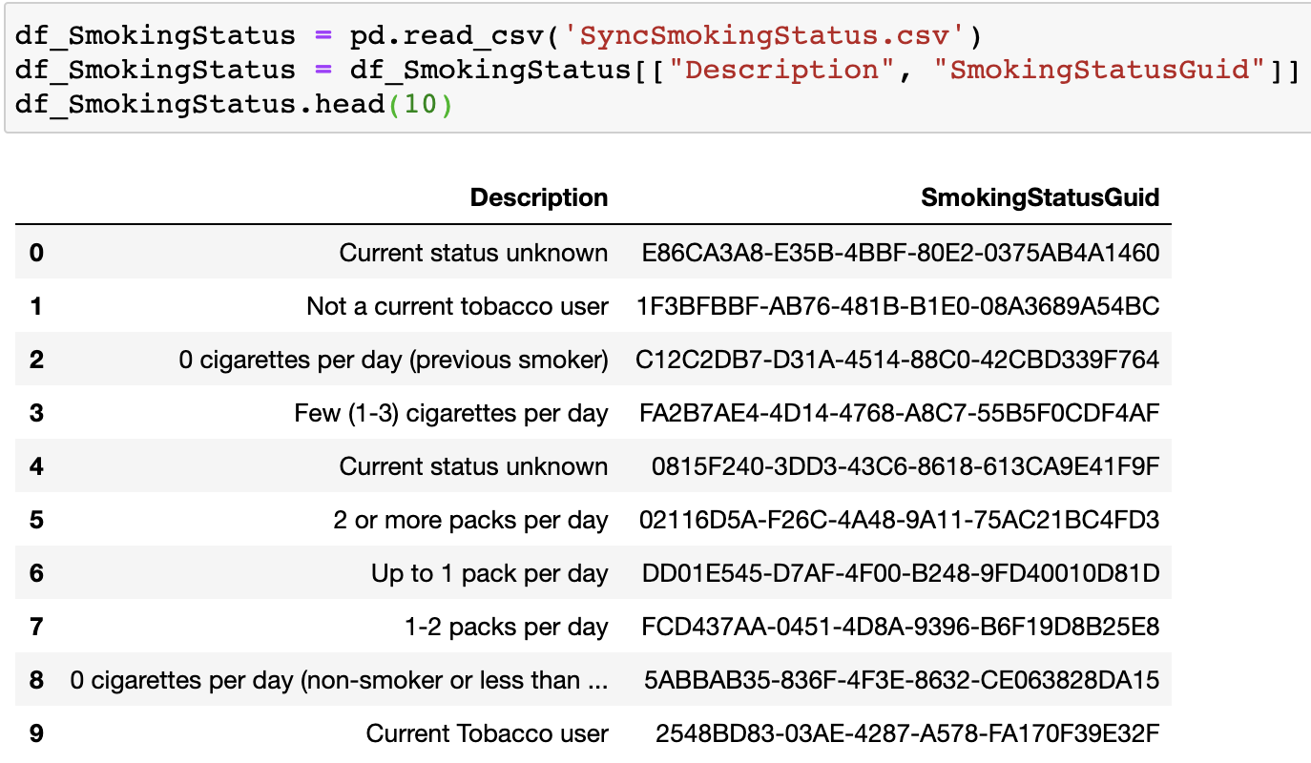
2. Select and process the existing files
2.1 Smoking Dataset

Slide 6
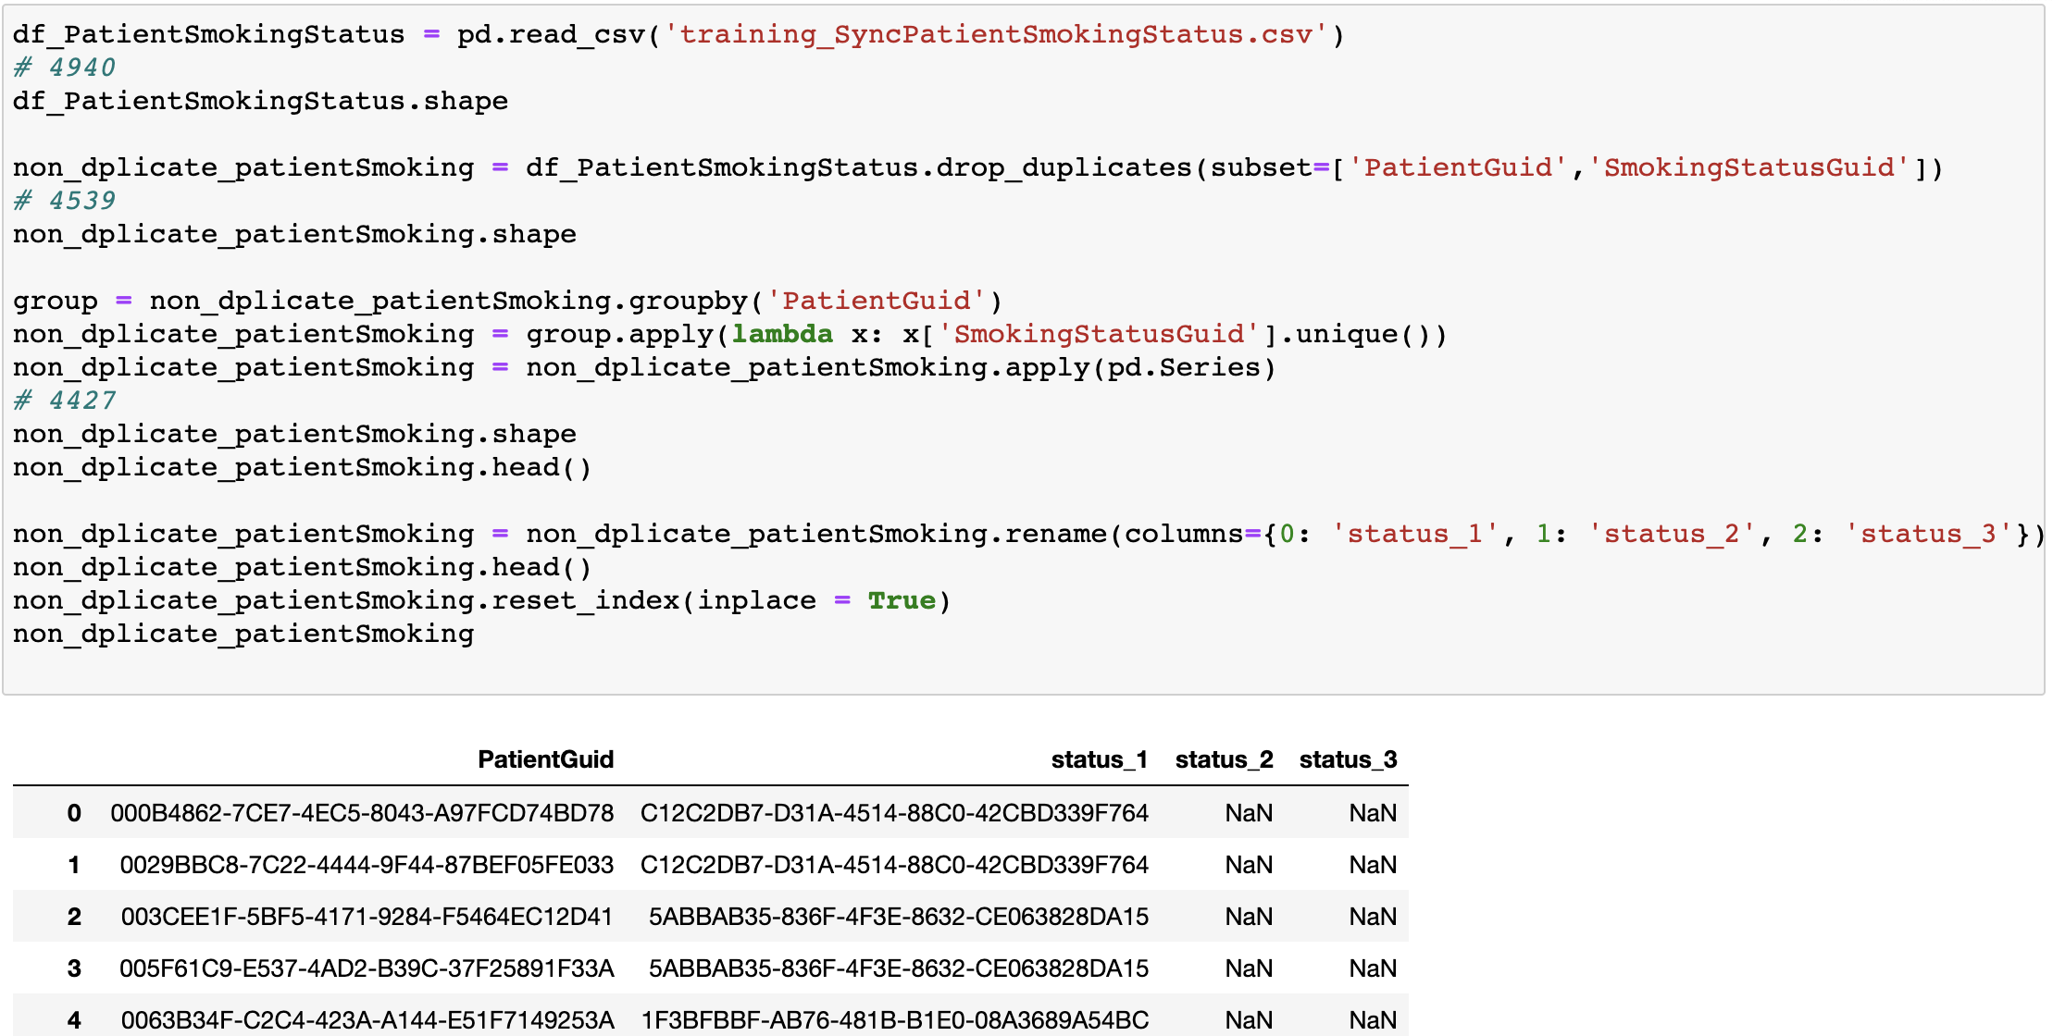
2. Select and process the existing files
2.1 Smoking Dataset

Slide 7
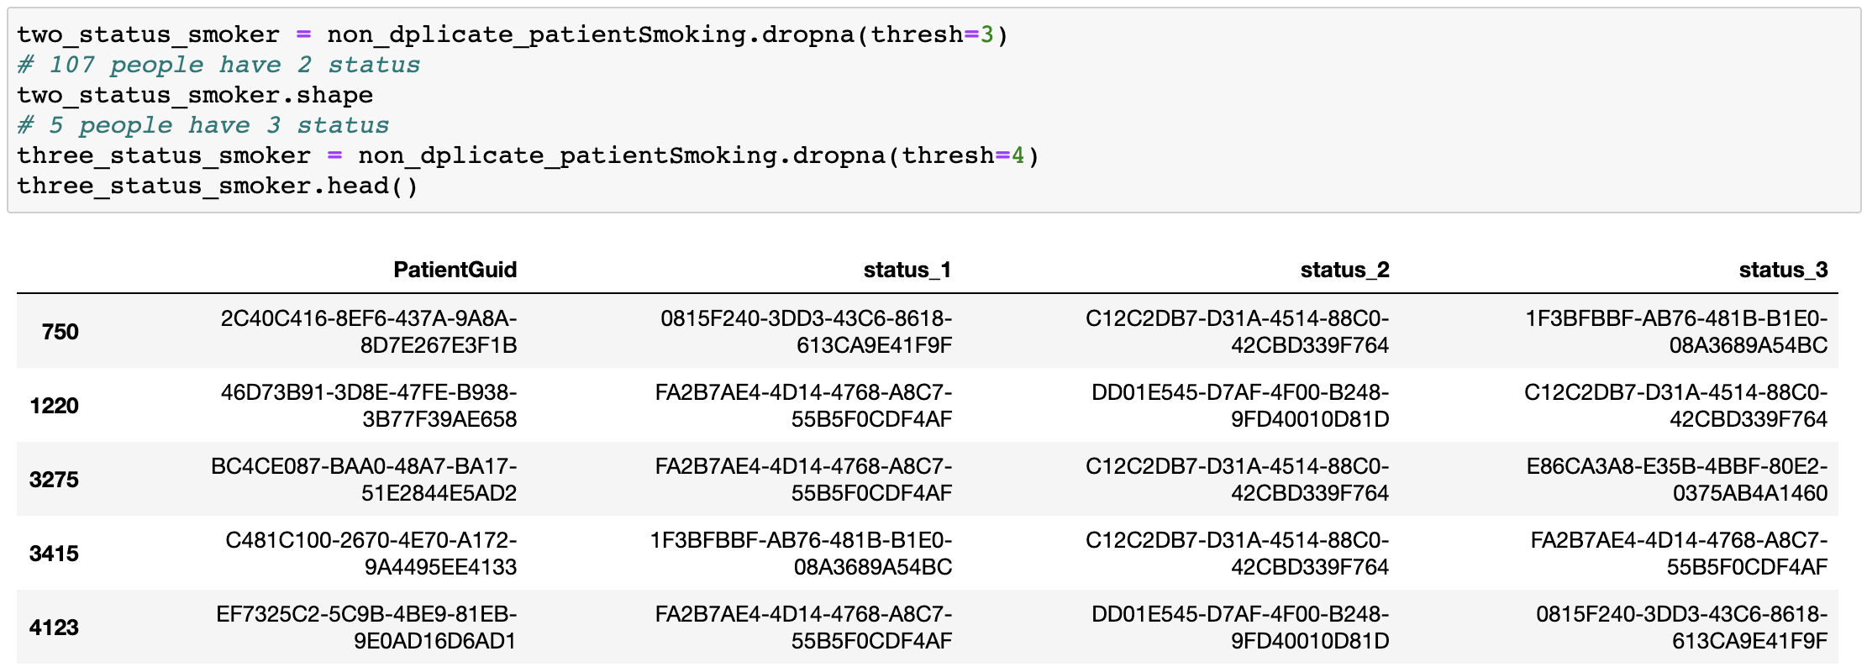
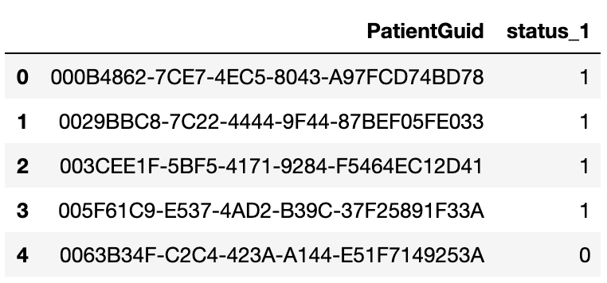
2. Select and process the existing files
2.1 Smoking Dataset

Slide 8
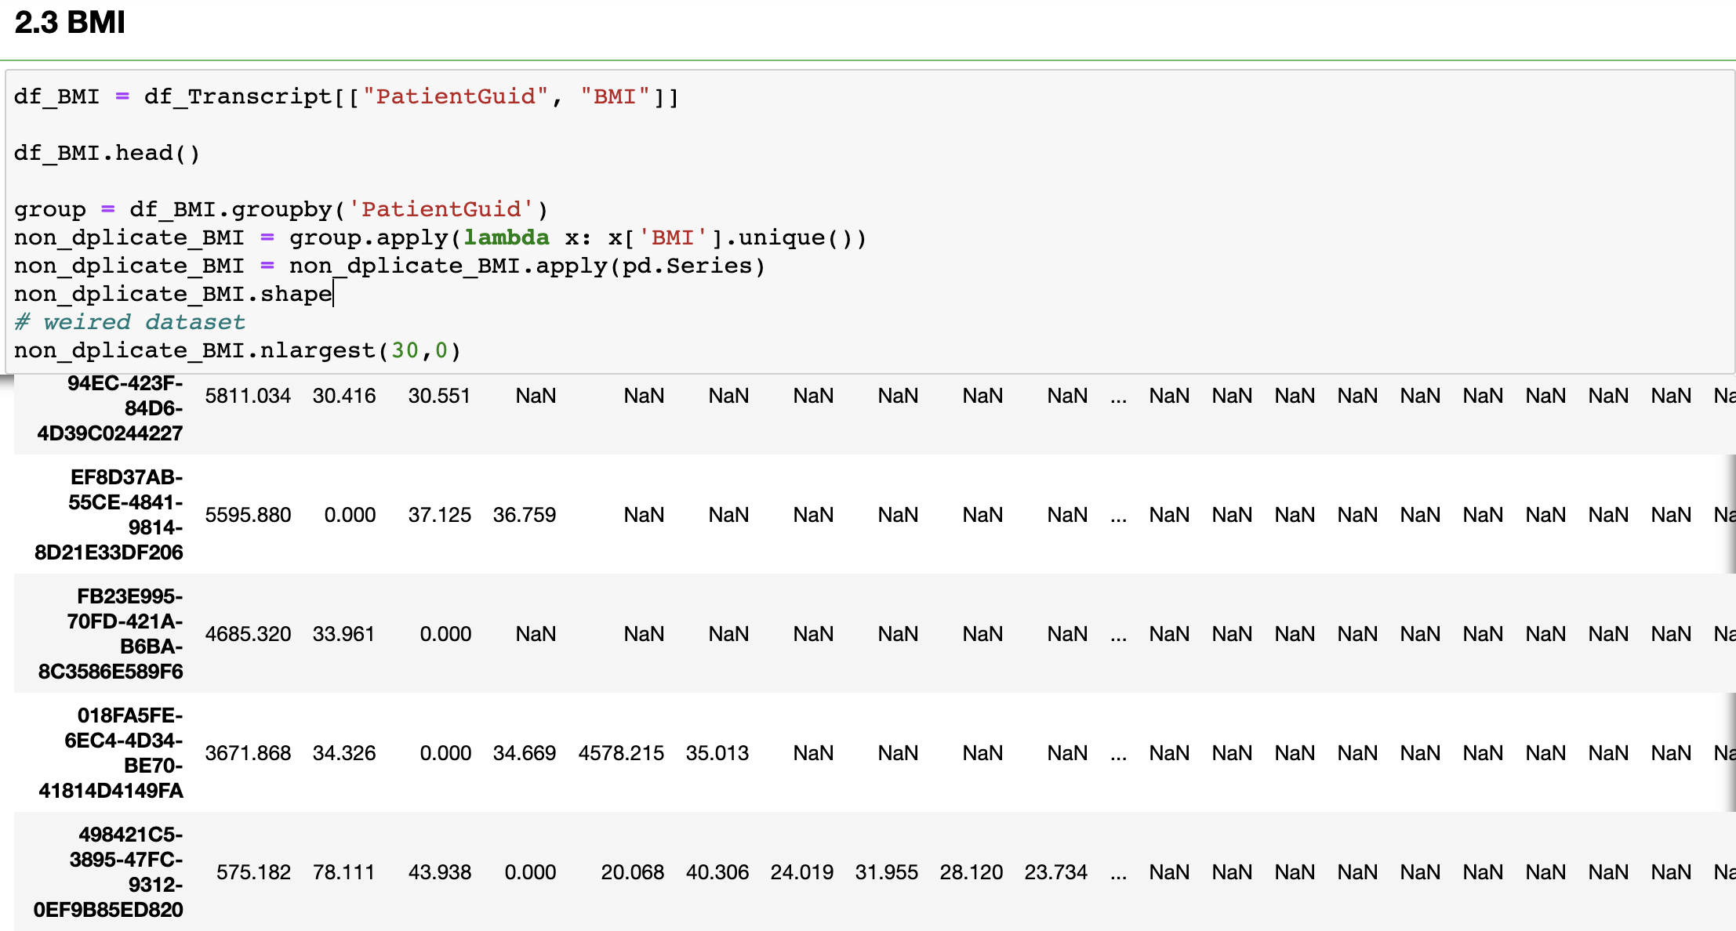
2. Select and process the existing files
2.2 Transcript -- BMI example
Weight,
Height,
BMI,
SystolicBP,
DiastolicBP,
RespiratoryRate,

Slide 9
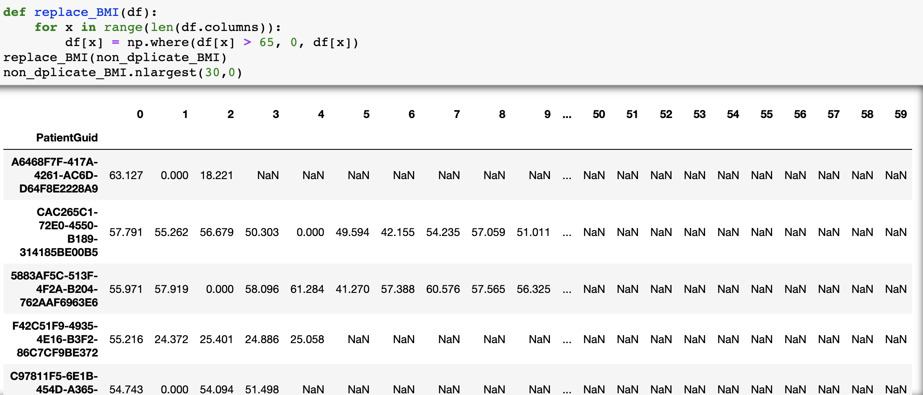
2. Select and process the existing files
2.2 Transcript -- BMI example

Slide 10
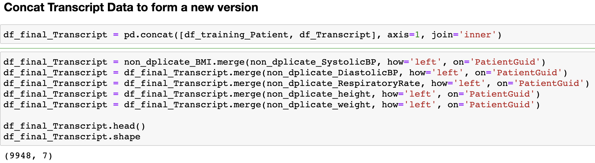
2. Select and process the existing files
2.2 Transcript -- Combine Transcript Data

Slide 11
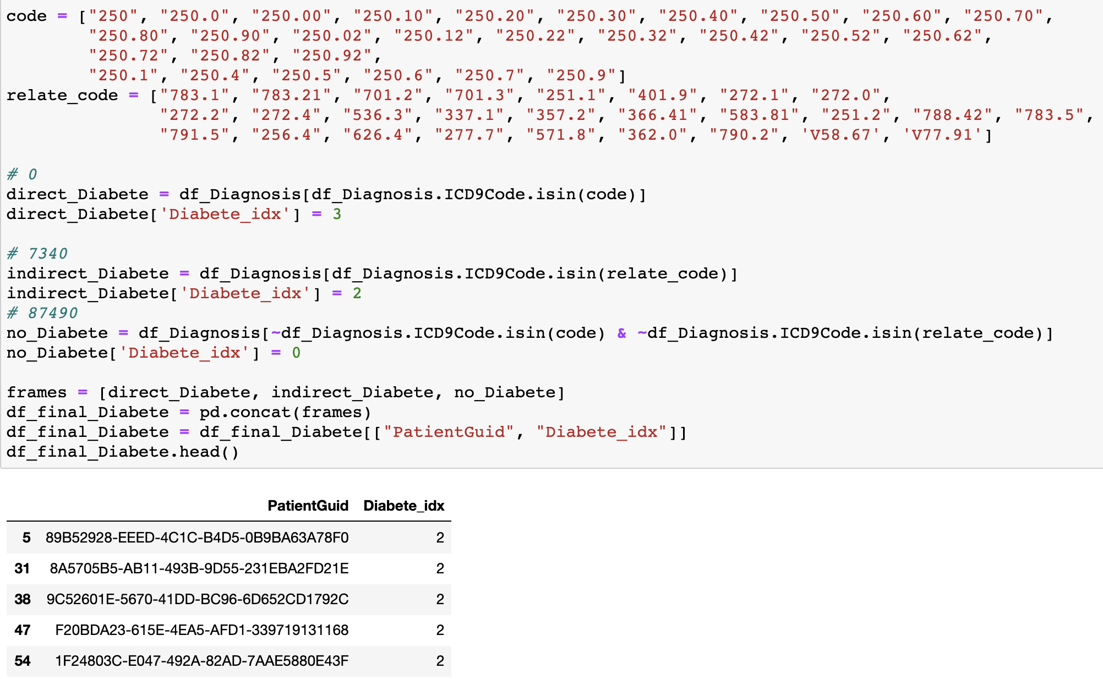
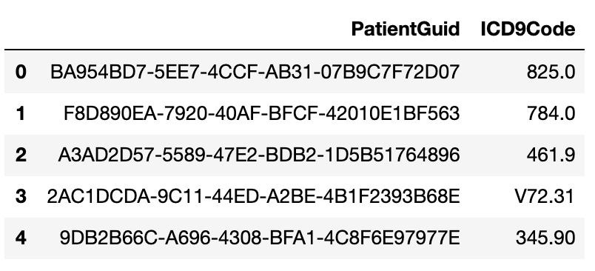
2. Select and process the existing files
2.3 Diagnosis

Slide 12
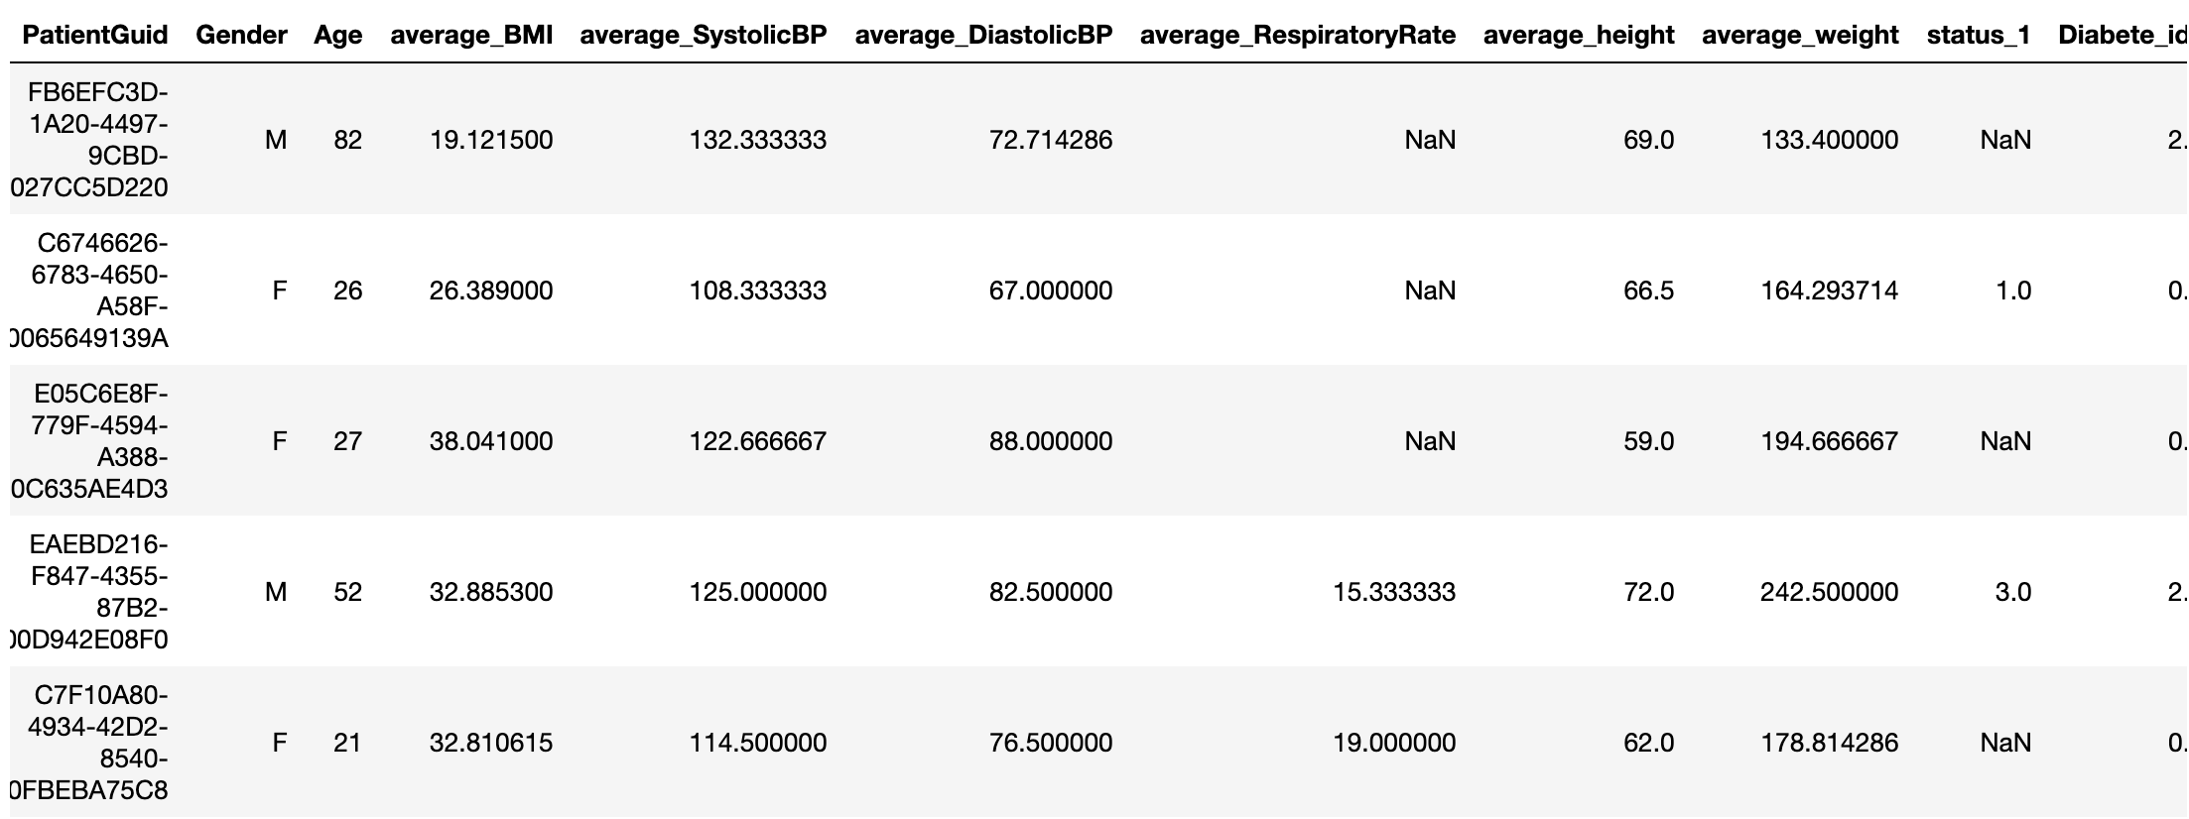
3. Combine the data to get the final file

Slide 13
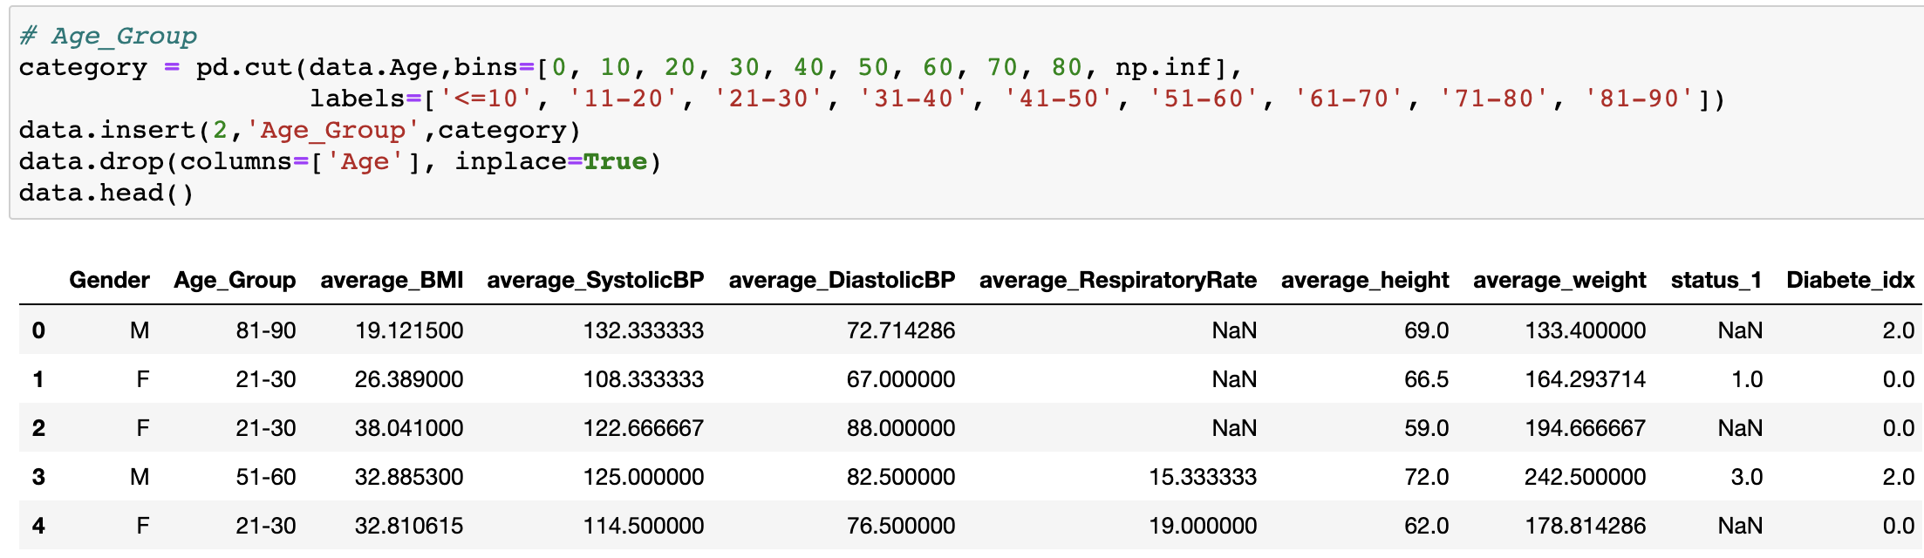
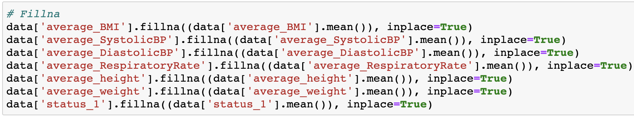
3. Combine the data to get the final file

Slide 14
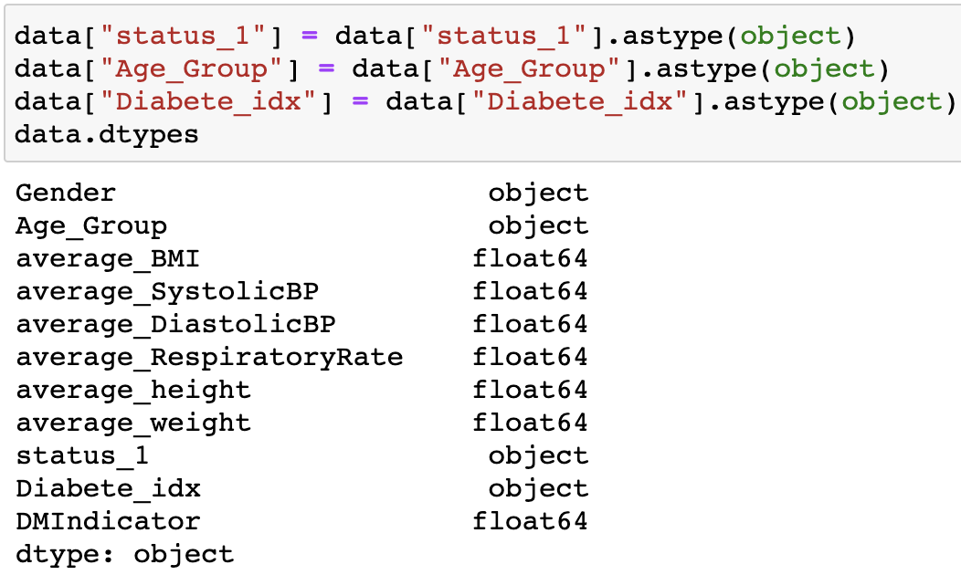
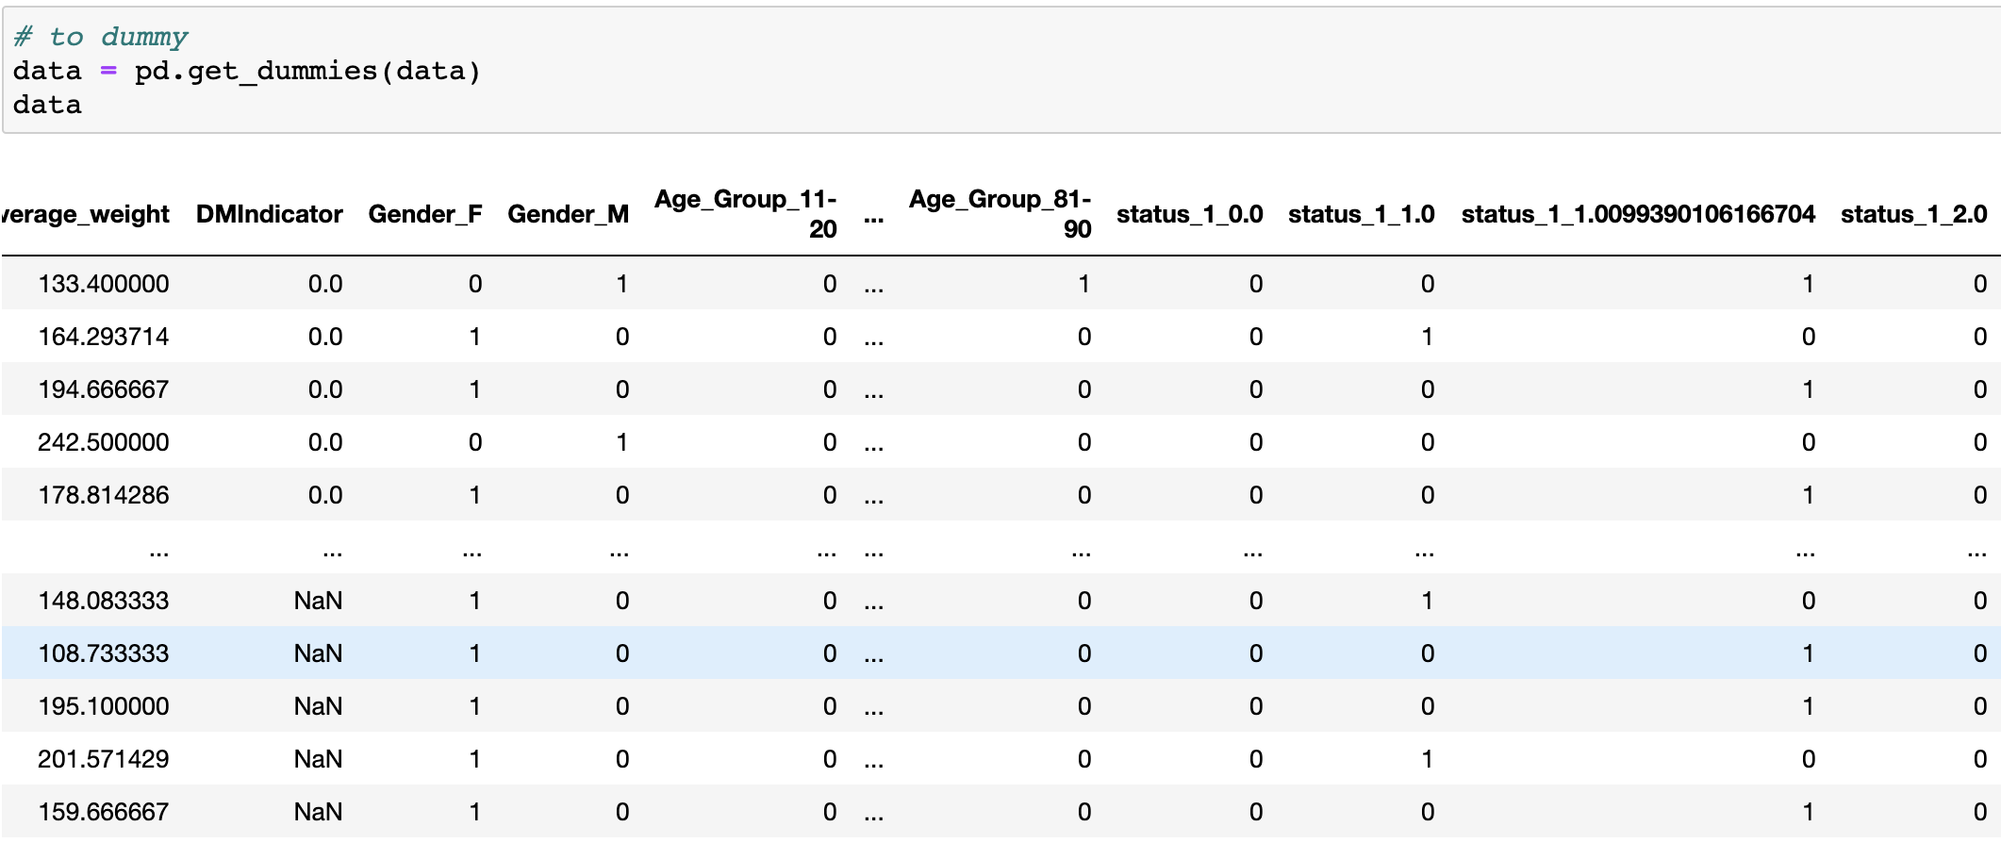
3. Combine the data to get the final file

Slide 15
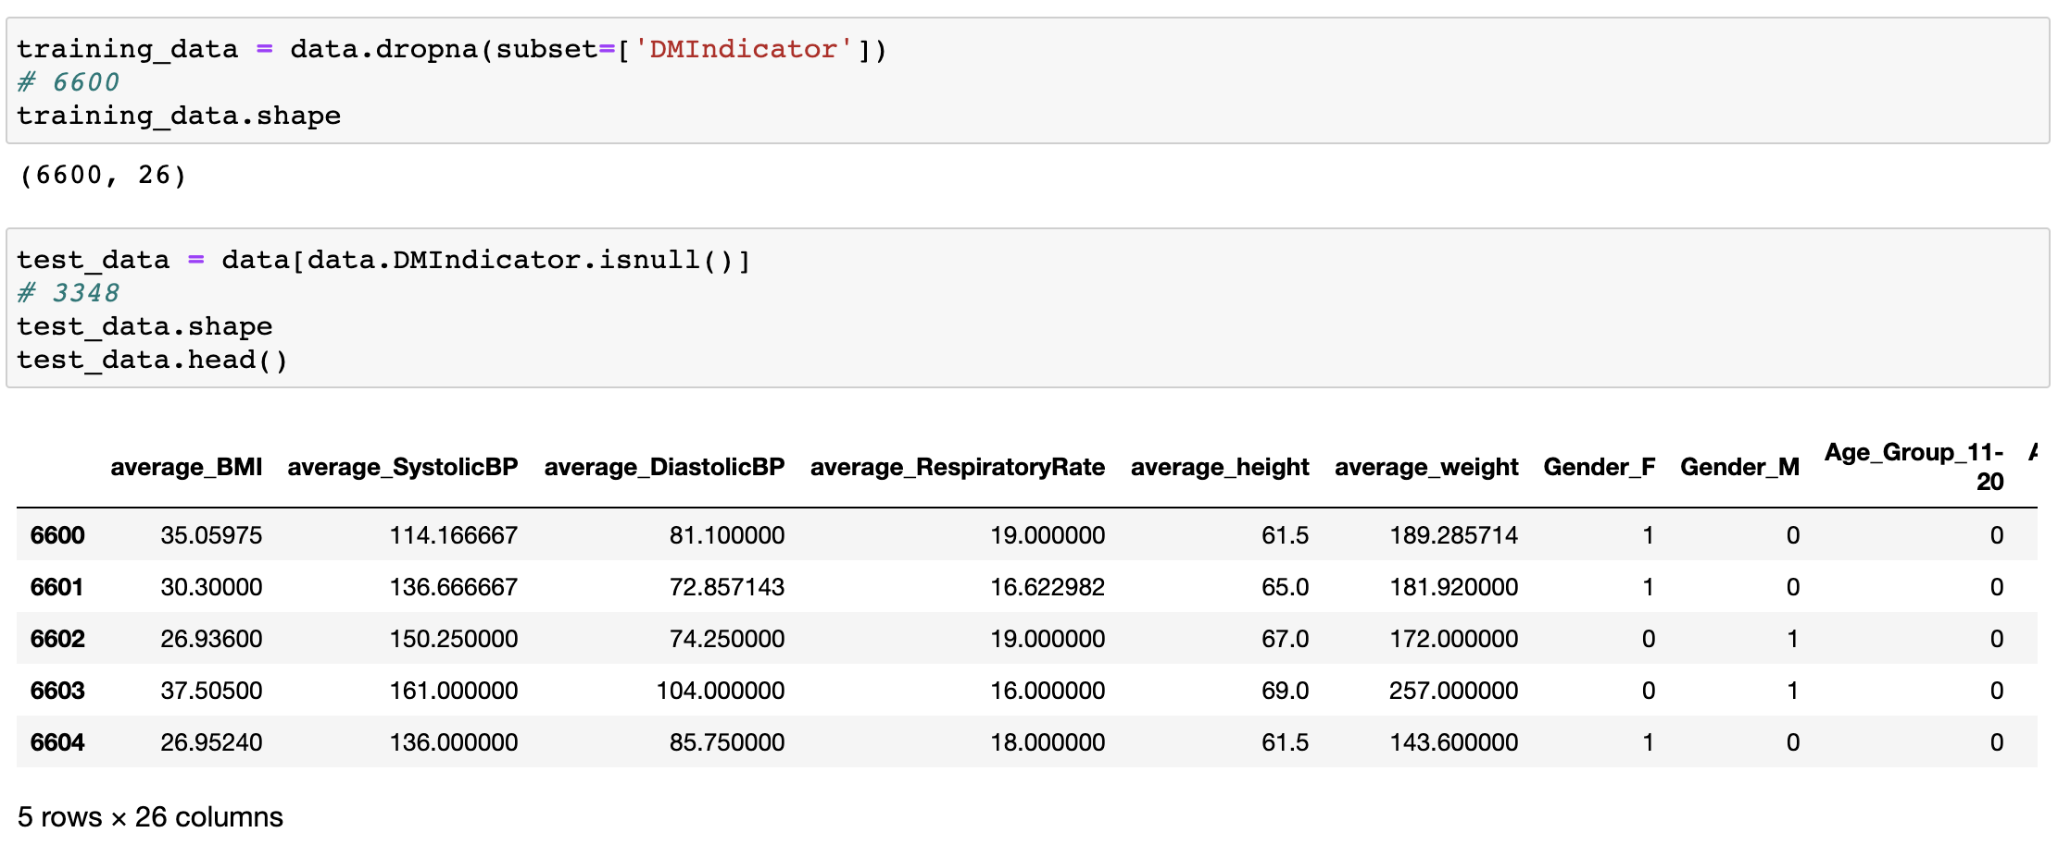
4. Split training & test data

Slide 16
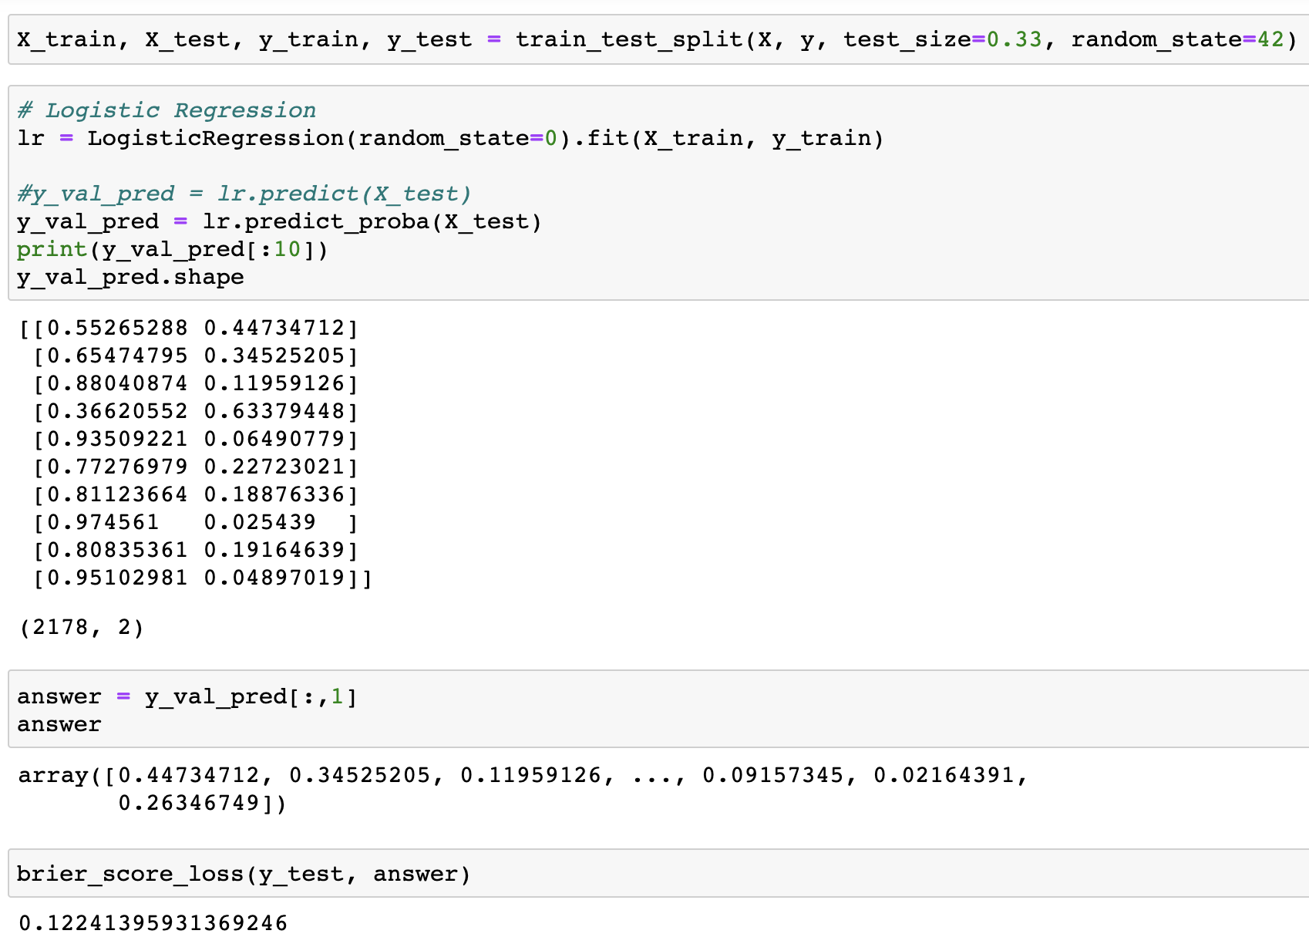
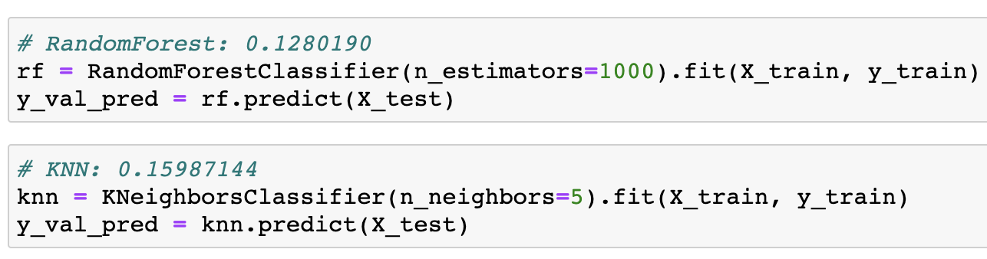
5. Build the model and predict

